Slide 1
CUSTOMER CHURN PREDICTION
greatlearning
Team Members
Harshit Agrawal
Hrishikesh Gupta Shubham Sharma
Sanket Wakalkar
Vasmi Krishna
Mentor
Mr. Jatinder Bedi
`

Slide 2


WHAT IS CUSTOMER CHURN ?
greatlearning

Slide 3
PROBLEM STATEMENT
greatlearning
The telecommunications industry experiences an average of 1.9% monthly and 22% annual churn rate. (SOURCE: GOOGLE)
We know that it costs 5-10 times more to acquire a new customer than to retain an existing one, customer retention has now become even more important than customer acquisition.
To reduce customer churn, telecom companies need to predict which customers are at high risk of churn. In this project, we will Analyze customer-level data of a leading telecom firm, build predictive models to identify customers at high risk of churn.
Here our goal is to build a machine learning model that is able to predict churn of customers based on the features provided for their usage.

Slide 4
FLOWCHART
greatlearning
DATA EXTRACTION
DATA PREPROCESSING
EXPLORATORY DATA ANALYSIS
DATA VISUALIZATION
MODEL DEPLOYMENT
MODEL EVALUATION
MODEL BUILDING
DATA PREPARATION

Slide 5
PREPROCESSING
greatlearning

Slide 6
EXPLORATORY DATA ANALYSIS
greatlearning
The dataset does not have any outliersoutliers
HEATMAP shows a very high relation between tenure and total charges
There were 11 null values in TotalCharges variable
The data is imbalanced with ratio of NO:YES as 73:27
EDA
Independent variables 17 categorical and 3 continuous
Adasyn method is used for balancing of data
Gender distribution is equal for male and female wrt churn
Train test split is being done

Slide 7
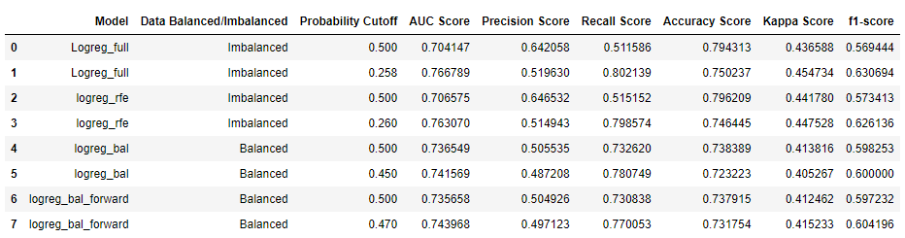
LOGISTIC REGRESSION
greatlearning
Logistic regression for both balanced and imbalanced data set is performed.

Slide 8
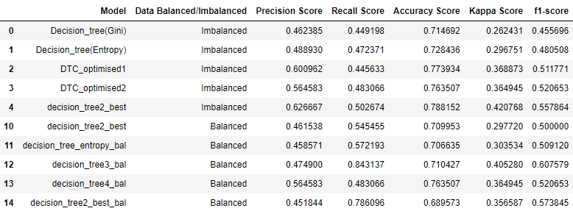
DECISION TREE
greatlearning

Slide 9

RANDOM FOREST
greatlearning

Slide 10
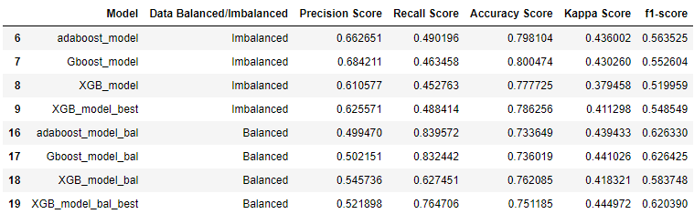
BOOSTING
greatlearning

Slide 11
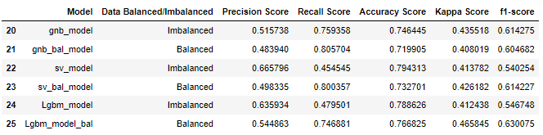
ADDITIONAL ALGORITHMS
greatlearning

Slide 12
greatlearning

Slide 13
CONCLUSION
greatlearning

